Slide 1
SNS ACADEMY
A fingerprint International School
Affiliated to CBSE New Delhi
Affiliation No :1930610
GRADE XII A (2020-21)
COURSE NAME : BIOLOGY(044)
Chapter-6 MOLECULAR BASIS OF INHERITANCE- THE SEARCH FOR GENETIC MATERIALS

Slide 2
Transforming Principle
Frederick Griffith - 1928
Streptococcus pneumonia
On culture media - some are smooth or shiny colonies (S)
-rough colonies (R)
Due to the presence and absence of mucous (polysaccharide)
crystal violet-nalidixic acid-gentamicin agar:CVNG)

Slide 3
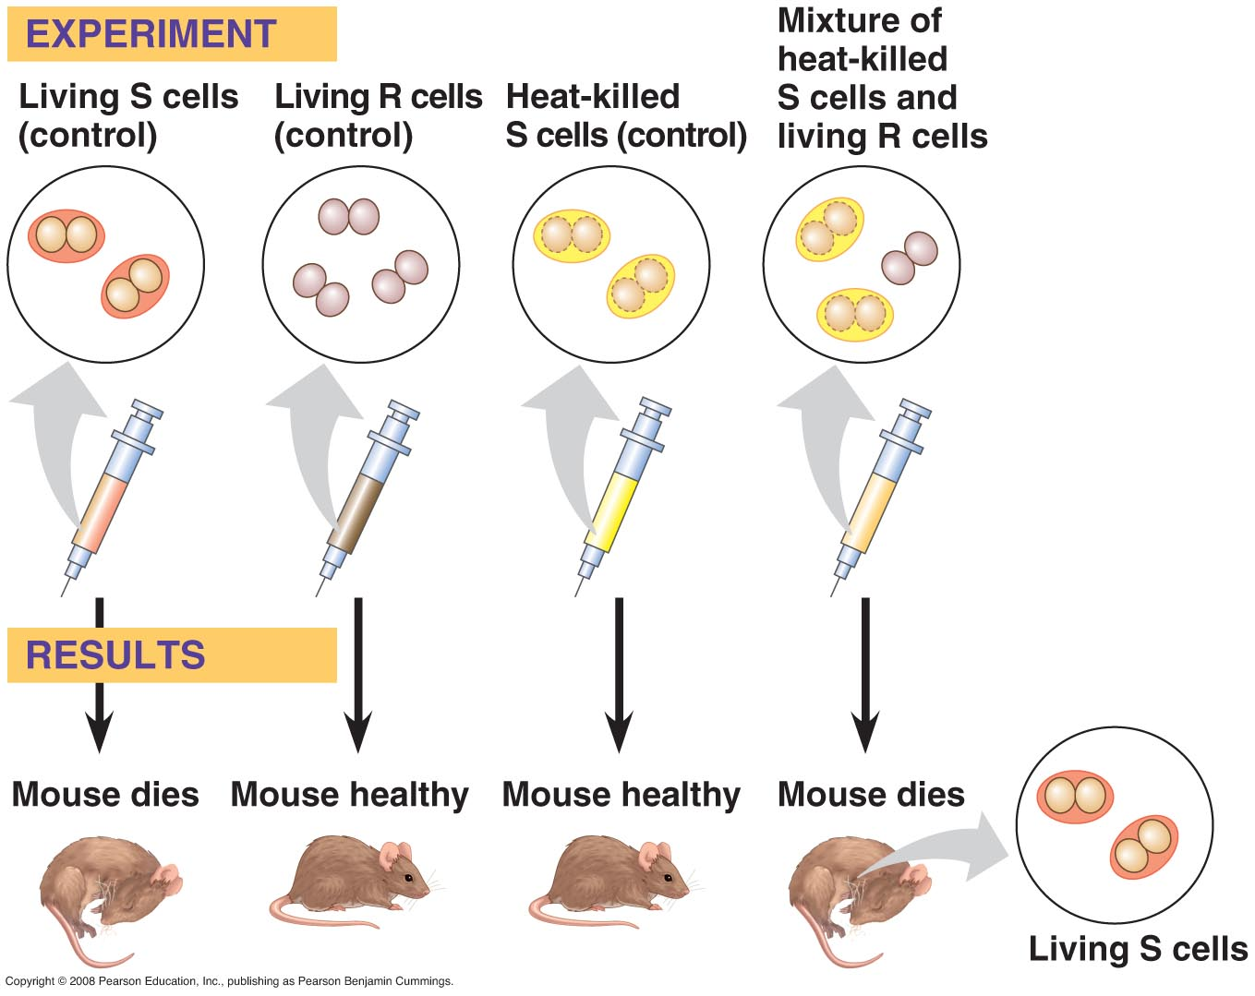
Frederick Griffith
Streptococcus pneumoniae model
S encapsulated and virulent; R non-encapsulated and non-virulent
Heat killed S cells mixed with R cells created S cells
Concluded that S cells have a chemical component that can transform other cells

Slide 5
Biochemical characteristics of transforming principle
Oswald avery, Colin MacLeod and Maclyn McCarty

Slide 7
Oswald Avery
Identified the transforming substance from Griffith’s work as DNA
Focused on DNA, RNA, and protein
Extract components from pathogenic bacteria
Each individually inactivated and tested for transformation ability
Degradation of DNA only substance to prevent
Not uniformly supported
Proteins better candidates
Doubted bacterial DNA similar to that of complex organisms
Little still known about DNA

Slide 8
Hershey and chase experiment
The proof – DNA is the genetic material – Alfred Hershey and Martha Chase.

